Slide 1


Subpoenas
Rachele Berglund
Attorney
HERR PEDERSEN & BERGLUND LLP
Attorneys at Law
100 Willow Plaza, Suite 300
Visalia, California 93291
Phone: (559) 636-0200
hpblaw.net

Slide 2
Objectives
What is a subpoena?
Who can issue a subpoena?
What are the different types?
Who may accept service?
What are different ways to respond?
Notes:
Will focus on civil law; few criminal snippets

Slide 3

What is a subpoena?
A legal document that
Commands a person or entity testify
At a specified time and place
And/or to produce documents
Notes:
A subpoena must command the person to whom it is directed to do either or both of the following:
Attend and give testimony at a deposition, hearing or trial;
Produce and permit inspection and copying of designated documents or tangible things in the possession, custody or control of that person.

Slide 4
True or False?
Complying with a subpoena is optional.
Notes:
FALSE - Mandatory
You must comply with the terms of the subpoena. There are various ways to comply. More on that later…

Slide 5

Who can issue a subpoena?
Attorney
Self-represented individual
Service hired by an attorney (Deposition Officer)
Court clerk or judge
Notes:
Who can “issue” a subpoena is different from who can “serve” a subpoena
Service – Do NOT serve the papers yourself!
Any person
At least 18 years old
Not involved in the case
And can fill out the Proof of Service form

Slide 6
Types of Subpoenas
Appearance Only
Records Only
Appearance and Records

Slide 7
JUDICIAL COUNCIL FORM NUMBER/DESCRIPTION | REVISED DATE
SUBP-001* Civil Subpoena for Appearance at Trial or Hearing | 01/01/2007
SUBP-OO2* Civil Subpoena (Duces Tecum) for Personal Appearance and Production of Documents, Electronically Stored Information, and Things at Trial or Hearing and Declaration | 01/01/2012
SUBP-010* Deposition Subpoena for Production of Business Records | 01/01/2012
SUBP-015* Deposition Subpoena for Personal Appearance | 01/01/2009
SUBP-020* Deposition Subpoena for Personal Appearance and Production of Documents and Things | 01/01/2009
CR-125* Order to Attend Court or Provide Documents: Subpoena/Subpoena Duces Tecum (Criminal and Juvenile) | 07/01/2007
Notes:
Forms marked with an asterisk (*) are adopted for mandatory use by all courts!

Slide 8

Where can I find these forms?
www.courtinfo.ca.gov

Slide 9
Directing Responses
Generally, responses are directed to:
Court
Deposition Officer

Slide 10
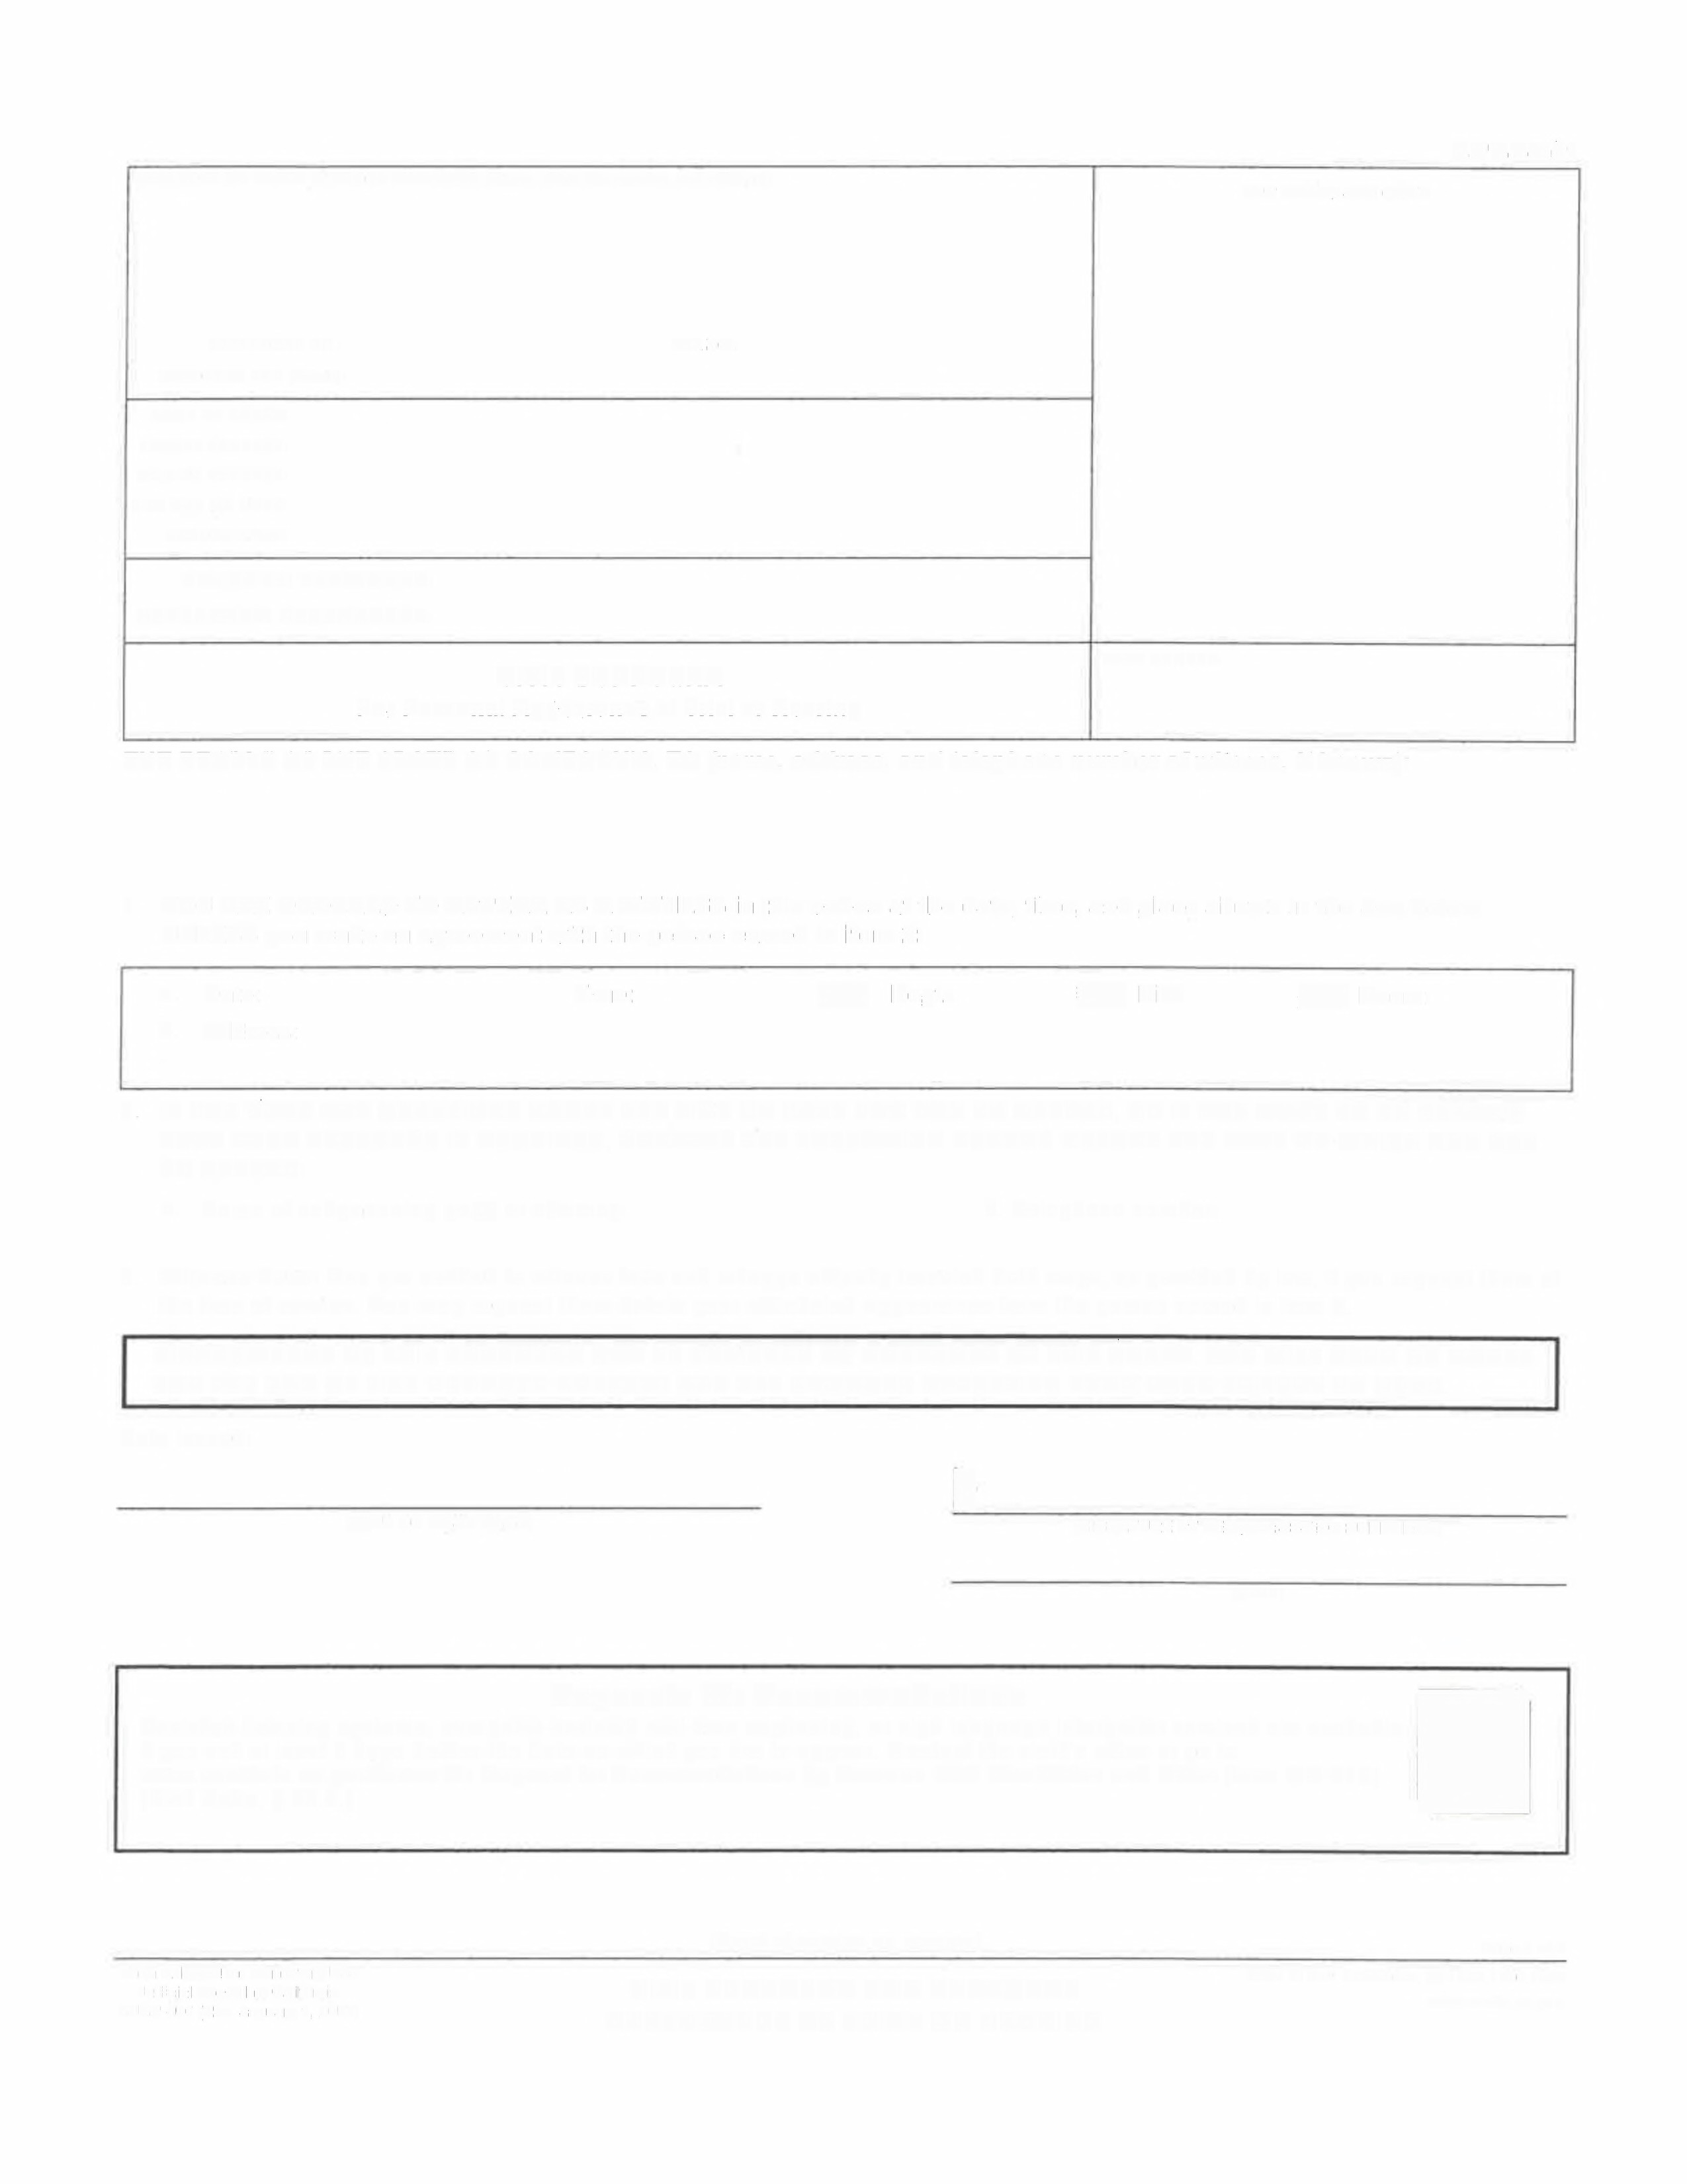
ATT ORNEY OR PARTY WITHOUT ATTORN EY (Name, State Bar number, and address):
FOR COURT USE ONLY
SUBP-001
TELEPHONE NO.:
ATTORNEY FOR (Name):
FAX NO.:
Type
NAME OF COURT:
STREET ADDRESS:
MAILING ADDRESS:
CITY AND ZIP CODE:
BRANCH NAME:
PLAINTIFF/ PETITIONER:
DEFENDANT/ RESPONDENT:
CIVIL SUBPOENA
For Personal Appearance at Trial or Hearing
CASE NUMBER:
THE PEOPLE OF THE STATE OF CALIFORNIA, TO (name, address, and telephone number of witness, if known):
Date, Time and Place to Appear
1. YOU ARE ORDERED TO APPEAR AS A WITNESS in this action at the date, time, and place shown in the box below
UNLESS you make an agreement with the person named in item 2:
a. Date:
b. Address:
Time:
[7Dept.
L7ow.
[]Room:
2. IF YOU HAVE ANY QUESTIONS ABOUT THE TIME OR DATE FOR YOU TO APPEAR, OR IF YOU WANT TO BE CERTAIN
THAT YOUR PRESENCE IS REQUIRED, CONTACT THE FOLLOWING PERSON BEFORE THE DATE ON WHICH YOU ARE
TO APPEAR:
Contact for Questions
a. Name of subpoenaing party or attorney:
b. Telephone number:
3. Witness Fees: You are entitled to witness fees and mileage actually traveled both ways, as provided by law, if you request them at the time of service. You may request them before your scheduled appearance from the person named in item 2.
DISOBEDIENCE OF THIS SUBPOENA MAY BE PUNISHED AS CONTEMPT BY THIS COURT. YOU WILL ALSO BE LIABLE
FOR THE SUM OF FIVE HUNDRED DOLLARS AND ALL DAMAGES RESULTING FROM YOUR FAILURE TO OBEY.
Date issued:
)
(TYPE OR PRINT NAME)
(SIGNATURE OF PERSON ISSUING SUBPOENA)
(TITLE)
Requests for Accommodations
Assistive listening systems, computer-
assisted real-time captioning, or sign language interpreter services are available
if you ask at least 5 days before the date on which you are to appear. Contact the clerk's office or go to
www .courtinfo.ca.gov/forms for Request for Accommodations by Persons With Disabilities and Order (form MC-410).
(Civil Code, § 54.8.)
Form Adopted for Mandatory Use Judicial Council of California SUBP-001 [Rev. January 1, 2007]
(Proof of service on reverse)
Page 1 of 2
Code of Civil Procedure, $S 1985,1986, 1987
www.courts.ca.gov
CIVIL SUBPOENA FOR PERSONAL
APPEARANCE AT TRIAL OR HEARING
Notes:
For personal appearance at trial or hearing

Slide 11

PLAINTIFF/PETITIONER:
DEFENDANT/RESPONDENT:
CASE NUMBER:
SUBP-001
PROOF OF SERVICE OF CIVIL SUBPOENA
FOR PERSONAL APPEARANCE AT TRIAL OR HEARING
1. I served this Civil Subpoena for Personal Appearance at Trial or Hearing by personally delivering a copy to the person served as follows:
a.
b.
Person served (name):
Address where served:
c.
d.
e.
Date of delivery:
Time of delivery:
Witness fees (check one):
(1) D were offered or demanded
and paid. Amount:..... S
(2) ] were not demanded or paid.
Page 2
Proof of Service
f.
Fee for service:
$
-----------
2.I received this subpoena for service on (date):
3. Person serving:
a.
b.
c.
d.
e.
f.
g.
h.
L7Not a registered California process server.
D California sheriff or marshal.
[] Registered California process server.
[] Employee or independent contractor of a registered California process server. D Exempt from registration under Business and Professions Code section 22350(b). D Registered professional photocopier.
D Exempt from registration under Business and Professions Code section 22451.
Name, address, telephone number, and, if applicable, county of registration and number:
Person Serving
I declare under penalty of perjury under the laws of the State
of California that the foregoing is true and correct.
(For California sheriff or marshal use only)
I certify that the foregoing is true and correct.
Date:
►
SUBP-001 [Rev. January 1, 2007]
Date:
►
PROOF OF SERVICE OF
CIVIL SUBPOENA FOR
PERSONAL APPEARANCE AT TRIAL OR HEARING
(SIGNATURE)
(SIGNATURE)
Page 2 of 2
For your prto ection ~ndprivacy, please press theleaCr]
This Form button after you have printed the form.
] Print this form ]] Save this form ]
I Clear this form I

Slide 12
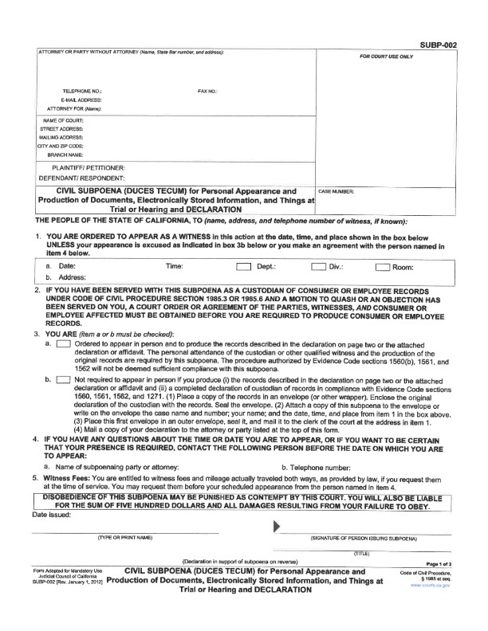
Type
Duces Tecum
Appearance and/or records to court
Date, time, place to appear or send records
Caution! Notice to Consumer
Instructions
Ordered to appear and take records; or
Mail records to court
Contact for questions or arrangements

Slide 13
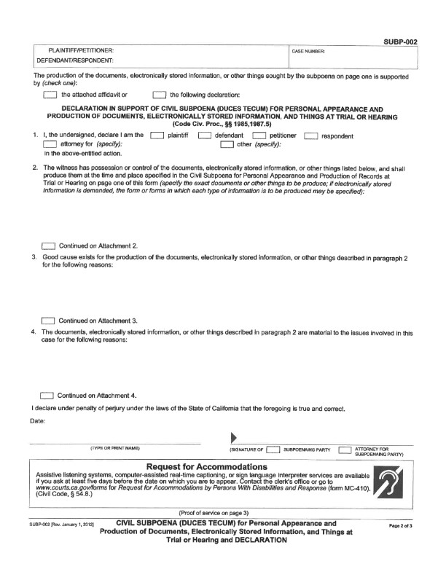
Description of records; why they are requested

Slide 14
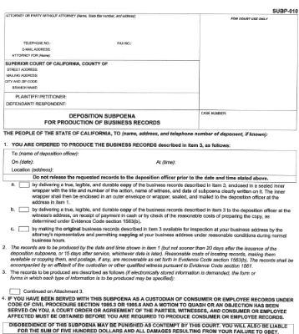
Type
Records only
Deposition
Due date; where to send records
Caution! Notice to Consumer
Instructions
Seal and mail; or
Copy for pick up; or
Allow inspection and copy
Description of records
Caution! Notice to Consumer

Slide 15
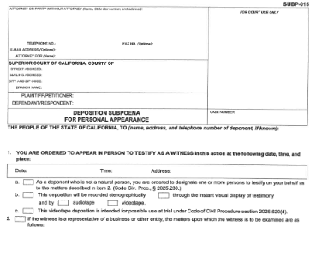
Type
Deposition
Appearance
Date, time and place to appear
Instructions
Who must testify
Description if audio/video used
What will be asked
How to change testimony after review

Slide 16
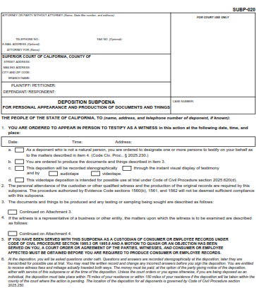
Type
Deposition
Appearance and documents
Date, time and place to appear
Instructions
Who must testify
Audio/video recorded
What will be asked
How to change testimony after review
Caution! Notice to Consumer
Description of records

Slide 17
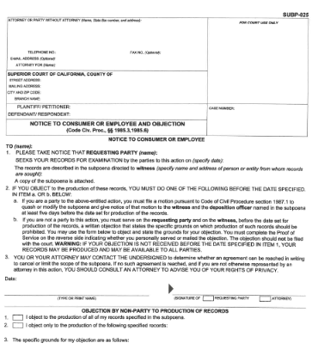
Notice to Consumer
Time to Object
Party: 5 days before date for production
Non-Party: Before date in #1
Notes:
Records of a customer (consumer) or an employee of the person or entity you are subpoenaing
Consumer records are records sought from telephone companies; banks, insurance and financial services providers; health care providers; schools; attorneys; or accountants.
“Consumer” means any individual, partnership of 5 or fewer persons, association or trust which has transacted business with, or has used the services of, the witness or for whom the witness has acted as agent or fiduciary. (CCP 1985.3)
“Employment records? Means the original or copy of books, documents, other writings pertaining to the employment of any employee maintained by the current or former employer of the employee, or by any labor organization that has represented or currently represents the employee. (CCP 1985.6)

Slide 18
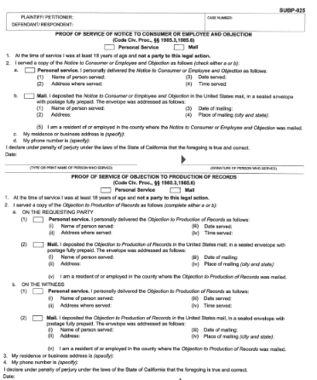
Proof of Service

Slide 19
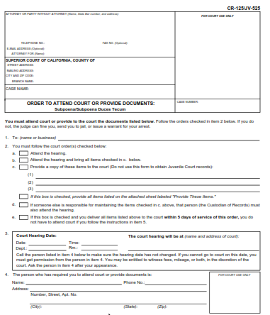
Type
Criminal
Appearance or
Produce records
Description of records
Date, time and place to appear or send records
Contact for questions or to make arrangements
Caution!
PC 1054.5
Notes:
Penal Code 1054.5
1054.5.
(a) Discovery for criminal cases must comply with this chapter – it’s the only means a defendant can compel disclosure or production of information from prosecuting attorneys, law enforcement agencies which investigated or prepared the case against the defendant, or any other persons or agencies which the prosecuting attorney or investigating agency may have employed to assist them in performing their duties.
(b) Before party seeks court enforcement of any disclosures required by this chapter, the party MUST FIRST make an informal request of opposing counsel for the desired materials/information. After 15 days and without production of the materials, then the party may seek a court order.
(c) The court may prohibit the testimony of a witness pursuant to subdivision (b) only if all other sanctions have been exhausted. The court shall not dismiss a charge pursuant to subdivision (b) unless required to do so by the Constitution of the United States.

Slide 20
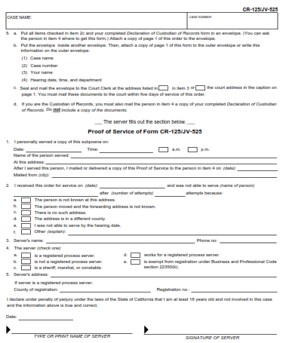
Directions
All items + Declaration of Custodian in envelope
Put the envelope inside another envelope
Attach a copy of Page 1 to outer envelop
Seal and deliver to Court Clerk
Custodian must also mail Person in #4 copy of completed Declaration – NOT documents
Proof of Service

Slide 21
Declaration of Custodian of Records – EV 1561
Who
Authorized custodian or qualified witness
What
Copy of true copy of all records described in the subpoena
How delivered
How prepared
Identity of records
If no records or only some records
Say so in the declaration

Slide 22
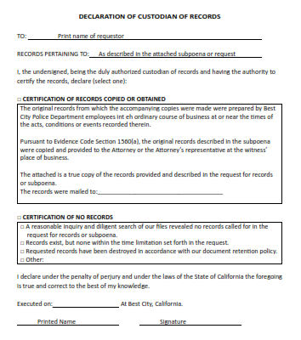


Slide 23
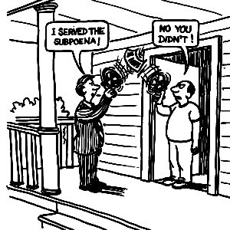
Who is authorized to accept service?
Review Department policies
Confer with your
supervisor/City Attorney
Make sure the person
“up front” is well-trained

Slide 24

Response Time
5 days Criminal
15 days Civil
Within the agreed-upon time
Authority:
Evidence Code section 1560(b)
Notes:
1560(b) Except as provided in Section 1564, when a subpoena duces tecum is served upon the custodian of records or other qualified witness of a business in an action in which the business is neither a party nor the place where any cause of action is alleged to have arisen, and the subpoena requires the production of all or any part of the records of the business, it is sufficient compliance therewith if the custodian or other qualified witness delivers by mail or otherwise a true, legible, and durable copy of all of the records described in the subpoena to the clerk of the court or to another person described in subdivision (d) of Section 2026.010 of the Code of Civil Procedure, together with the affidavit described in Section 1561, within one of the following time periods:
(1) In any criminal action, five days after the receipt of the subpoena.
(2) In any civil action, within 15 days after the receipt of the subpoena.
(3) Within the time agreed upon by the party who served the subpoena and the custodian or other qualified witness.

Slide 25
True or False?
All responses are the same.
Notes:
FALSE. Responses to a subpoena will differ depending upon whether the subpoena is for testimony or documents and many other variables.

Slide 26
Response Types
Produce
Object
Quash
Protective Order

Slide 27
Protective Orders
May move for a protective order before the time for compliance.

Slide 28
Common Scenarios
Subpoena received by City/PD issued in a civil case in Family Court – underlying case involves allegations of child abuse by one of the parents
Subpoena received by City/PD issued in a civil case – underlying case is an ongoing criminal investigation

Slide 29
Undue Burden and Expense
A party causing a subpoena to issue must take reasonable steps to avoid imposing undue burden or expense on the person served.

Slide 30

Undue Burden?
Subpoena for: All communications for the period between 01/01/2000 and present between any Best City Police Department employee and any Other Company employee concerning ABC.

Slide 31
Option: Refuse to obey?
Complying with a subpoena is required.
“Disobedience of this subpoena may be punished as contempt by this court. You will also be liable for the sum of five hundred dollars and all damages resulting from your failure to obey.”
Notes:
In a felony case: not exceeding $500
In a misdemeanor case: not exceeding $100

Slide 32
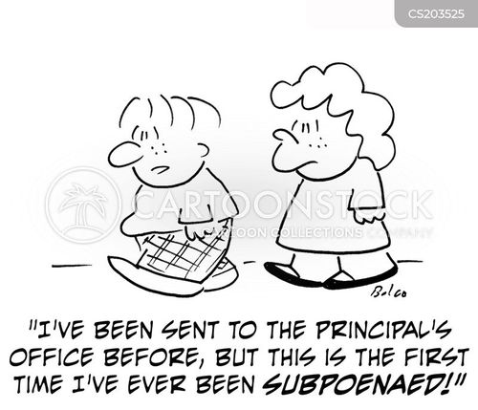
What is “disobedience of a subpoena”?
Failing to appear as set out in the subpoena
Refuse without legal cause to produce evidence in possession, when required by subpoena

Slide 33
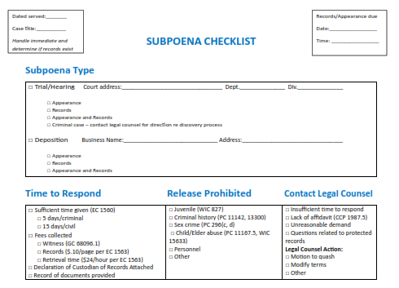

Slide 34
Reliable Resources
uscourts.gov State and Federal court system overview, common legal terms
courtinfo.ca.gov Information, forms used I California court legal system
leginfo.ca.gov California statutes, California Constitution, legislative information

Slide 35

Rachele Berglund
Email: rberglund@hpblaw.net
Phone: 559-636-0200
Rachele Berglund
Attorney
RBerglund@hpblaw.net
HERR PEDERSEN & BERGLUND LLP
Attorneys at Law
100 Willow Plaza, Suite 300
Visalia, California 93291
Phone: (559) 636-0200
hpblaw.net

